Slide 1
Address bus
Data bus
Types of Communication CPU Buses
Control bus
Done by: Mohamad Luqman Idlan bin Mohamad Azahari
Matric: 1723539

Slide 2
1. Address Bus- carries memory addresses from the processor to other components such as primary storage and input/output devices. The address bus is unidirectional. 2. Data bus - carries the data between the processor and other components. The data bus is bidirectional 3. Control bus - carries control signals from the processor to other components. The control bus also carries the clock's pulses. The control bus is unidirectional

Slide 3


EXAMPLES OF BUSSES
Main buses

Slide 4
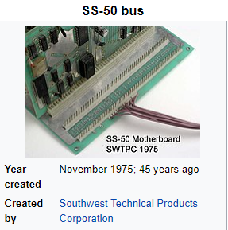
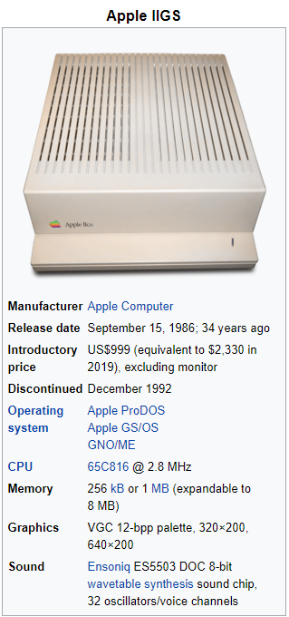
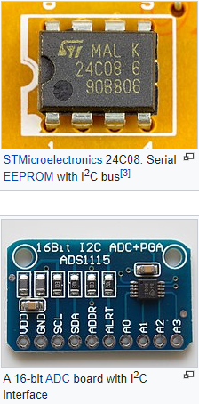
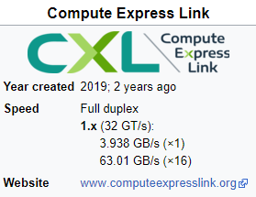

Slide 5
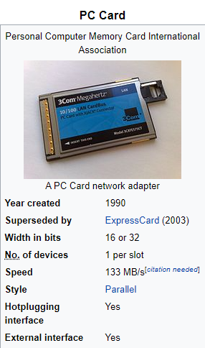

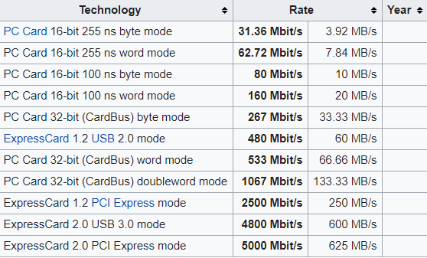
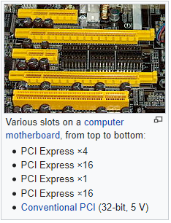
Portable

Slide 6
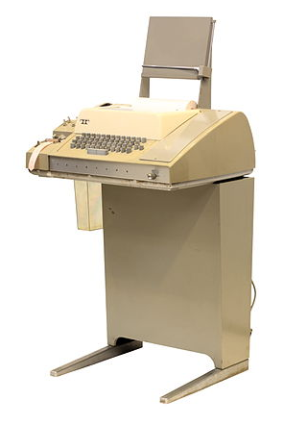
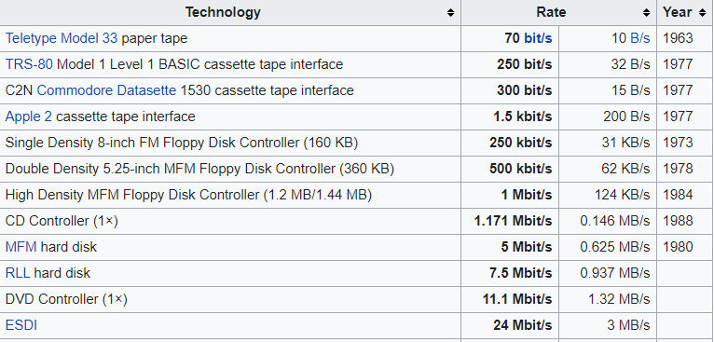
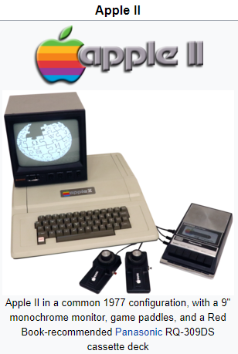
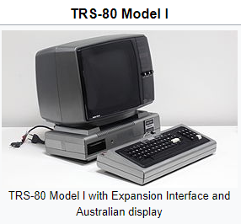
Storage

Slide 7

